Slide 1


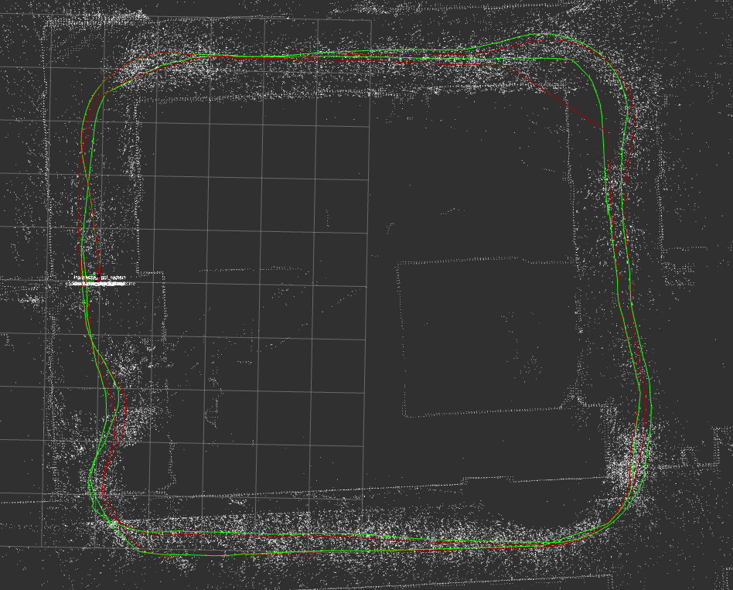
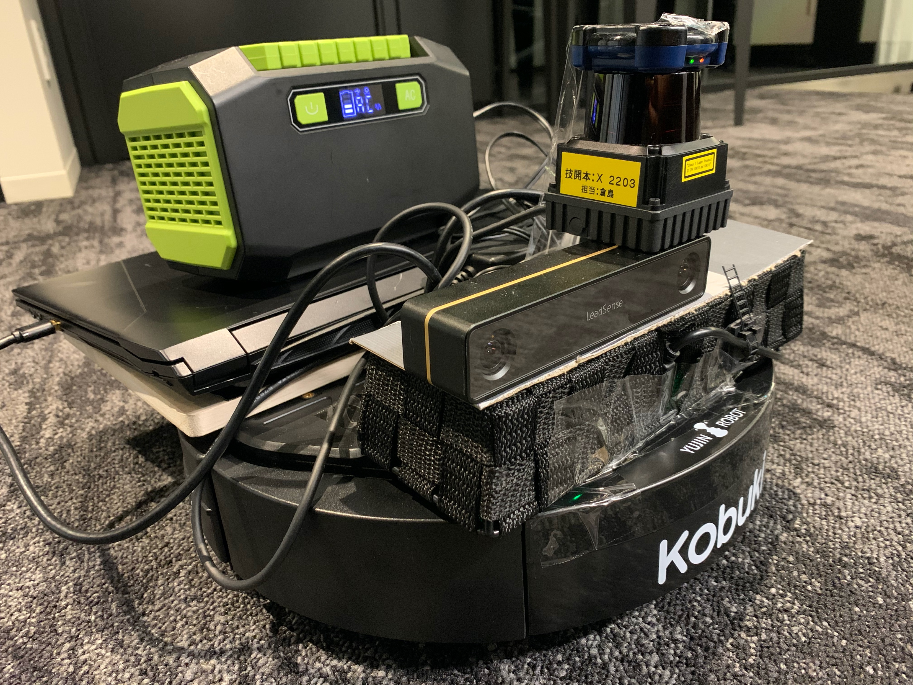
Visual-LiDAR-odometry fusion SLAM
Project Number: 19-3-2-1990
Names: Kengo Akano
Advisor: Tatsuya Aizawa
Introduction SLAM (simultaneous localization and mapping) is a method used for autonomous vehicles that lets you build a map and localize your vehicle in that map at the same time. There are a growing number of technology components used to achieve SLAM. In this project, We will explore two of the popular methods of SLAM; visual SLAM and Lidar SLAM; additionally wheel odometry. They have advantages and disadvantages such as below. Objectives As the researchers in the domains of visual SLAM and 2D Lidar SLAM barely work together, it is hard to find existed projects working on the fusion SLAM of them. Thus, we resulted in assuming that the synthesis SLAM supplemented the disadvantages of visual SLAM with 2D Lidar SLAM and wheel odometry is more robust and inventive if we can integrate. Methods/Implementation The experiments based on robotic operating system (ROS) kinetic, C++ coding, and turtleBot2 KOBUKI, using stereo-camera and LiDAR to acquire visual information and 2D laser scanned matching data for each, KdSLAM provided from Kudan Inc. and an open source LittleSLAM package for 2D Lidar SLAM. | Algorithm First, we implemented on ROS the first fusion SLAM(A) based on Little SLAM which makes a point cloud map by scan-matching algorithm with the scan data of Lidar from each frame and initial pose from the output of KdSLAM. Second, we coded to subscribe wheel odometry from TurtleBot2 and publish it to SLAM when the camera lost the visual information (B). Robot we integrated Hokuyo LiDAR, LeadSense Stereo Camera, and mobile buttery on turtleBot2 KOBUKI. Test run KOBUKI runs two loops; it nomally runs until loop closure and mapping completion in the first loop and we sometimes masked the camera in the middle of the second loop to see if wheel odometry was properly called and draw path instead of KdSLAM. | Results The result of the test run is that mapping is faultless, processing is slightly slow and path is almost precise even though the camera was partially masked. Conclusions In conclusion, the path and map results show that the developed SLAM is robust and precise enough to assist the assumption is correct. According to the test results, we can say Visual-LiDAR-odometry fusion SLAM has a potential to become a popular method of SLAM in the research and commercial field. Bibliography [1] M. Tomono. ”Introductory guide to simultaneous localization and mapping (SLAM入門)”, Ohmsha, Ltd., 2019. [2] MathWorks – ”Whar Is SLAM? 3 things you need to know", https://www.mathworks.com/discovery/slam.html
ーー：Visual SLAM (KdSLAM) → Lost during the camera is masked
ーー：Fusion SLAM (KdSLAM+LittleSLAM＋WheelOdometry)
→ Precisely plots the path even though the camera is masked
Input device
2D Lidar
Little SLAM
(2D)
Outputs
Point cloud map
path
Pros
Cons
Can be implemented at low cost with relatively inexpensive cameras
Detect a landmarks since cameras provide a large volume of information
Can be achieved flexibility in SLAM implementation
Not accurate or lose tracking when a robot is inside the small building has monotonic walls or dark place
If a single camera as the only sensor, it is challenging to define depth
Odometry information
Visual SLAM
Stereo-camera
KdSLAM
(Visual)
A
The stereo-camera
is masked
Conditional branch
A: Default
B: When the visual information
is lost such as the dark and
no texture environment.
Provides high-precision distance measurements which works very effectively for map construction with SLAM
Used for applications with high-speed moving vehicles
Works even in the dark environments
Lidar is relatively expensive
point clouds are not as sufficiently detailed as images in terms of density for matching
Point cloud matching generally requires high processing power
turtleBot2
Wheel
Odometry
2D Lidar SLAM
B
Wheel Odometry
Can be acquired from the robot wheel without the additional hardware implementation
Slip and Idling can be happened due to the floor material and steps
Error of rotation direction
2D LiDAR
Stereo-camera
turtleBot2

